Slide 1
Using conjunctions to express time, place or cause.

Slide 2
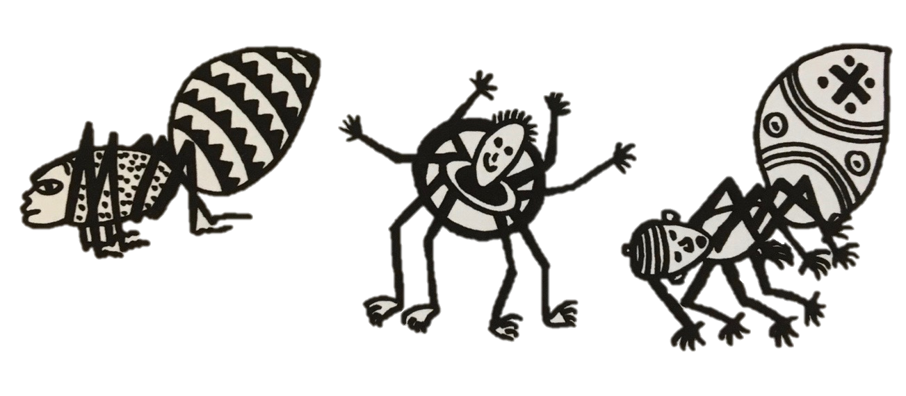
Verbs
A verb indicates what someone or something is doing, feeling or being.
He climbs.
The spider is crafty.
The villagers despair.
I saw him!
Revision

Slide 3
Verb Phrases
A verb phrase can be a single verb or a string of verbs.
The other animals think he is tricky.
He has had all sorts of adventures.
He has been causing problems for everyone.
Revision

Slide 4
Clauses
Clauses are groups of words with a verb phrase and a subject.
Ananse lives in a village.
He looks like a spider.
The other animals think he is tricky.
He has had all sorts of adventures.
Revision

Slide 5
Conjunctions
Conjunctions are words that join clauses into sentences.
CLAUSE
CONJUNCTION
CLAUSE
He is extremely unusual because he is a spider man.
Revision

Slide 6
Conjunctions for time
Conjunctions help us express time, place and cause.
He dropped the pot…
while he was climbing.
When?
He dropped the pot…
after he had almost reached the top.
When?
He dropped the pot…
when he started to show off .
When?
Try adding your own clauses to express time.

Slide 7
Conjunctions for place
Conjunctions help us express time, place and cause.
Where?
The pot broke…
where it hit the ground.
The pot broke…
where it fell.
Where?
The pot broke…
where the people had been cheering.
Where?
Wherever is useful for more general statements.
You find mess wherever you have a puppy.
I like to take photos wherever I go.
Toddlers leave sticky fingerprints wherever they play.
Try adding your own clauses to express place.

Slide 8
Conjunctions
Conjunctions help us express time, place and cause.
Ananse was ashamed…
because he had not succeeded.
Why?
Ananse was ashamed…
as he had been so foolish.
Why?
Ananse was ashamed…
since everyone had seen him fail.
Why?
Try adding your own clauses to express cause.

Slide 9
Conjunctions
Conjunctions are words that join clauses into sentences.
Cause
Time
Place
because
after
where
before
wherever
as
when
so
since
since
until
as
while

Slide 10
End

